Slide 1


Slide 2


Slide 3
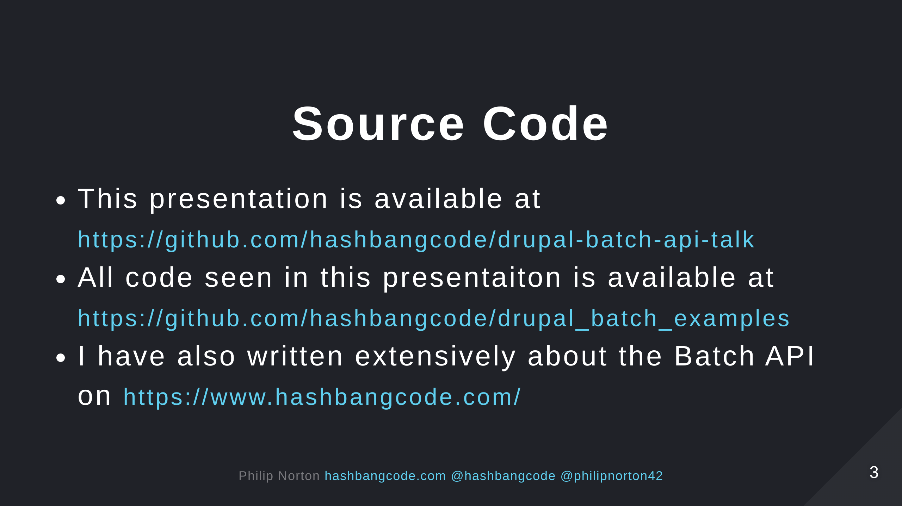

Slide 4
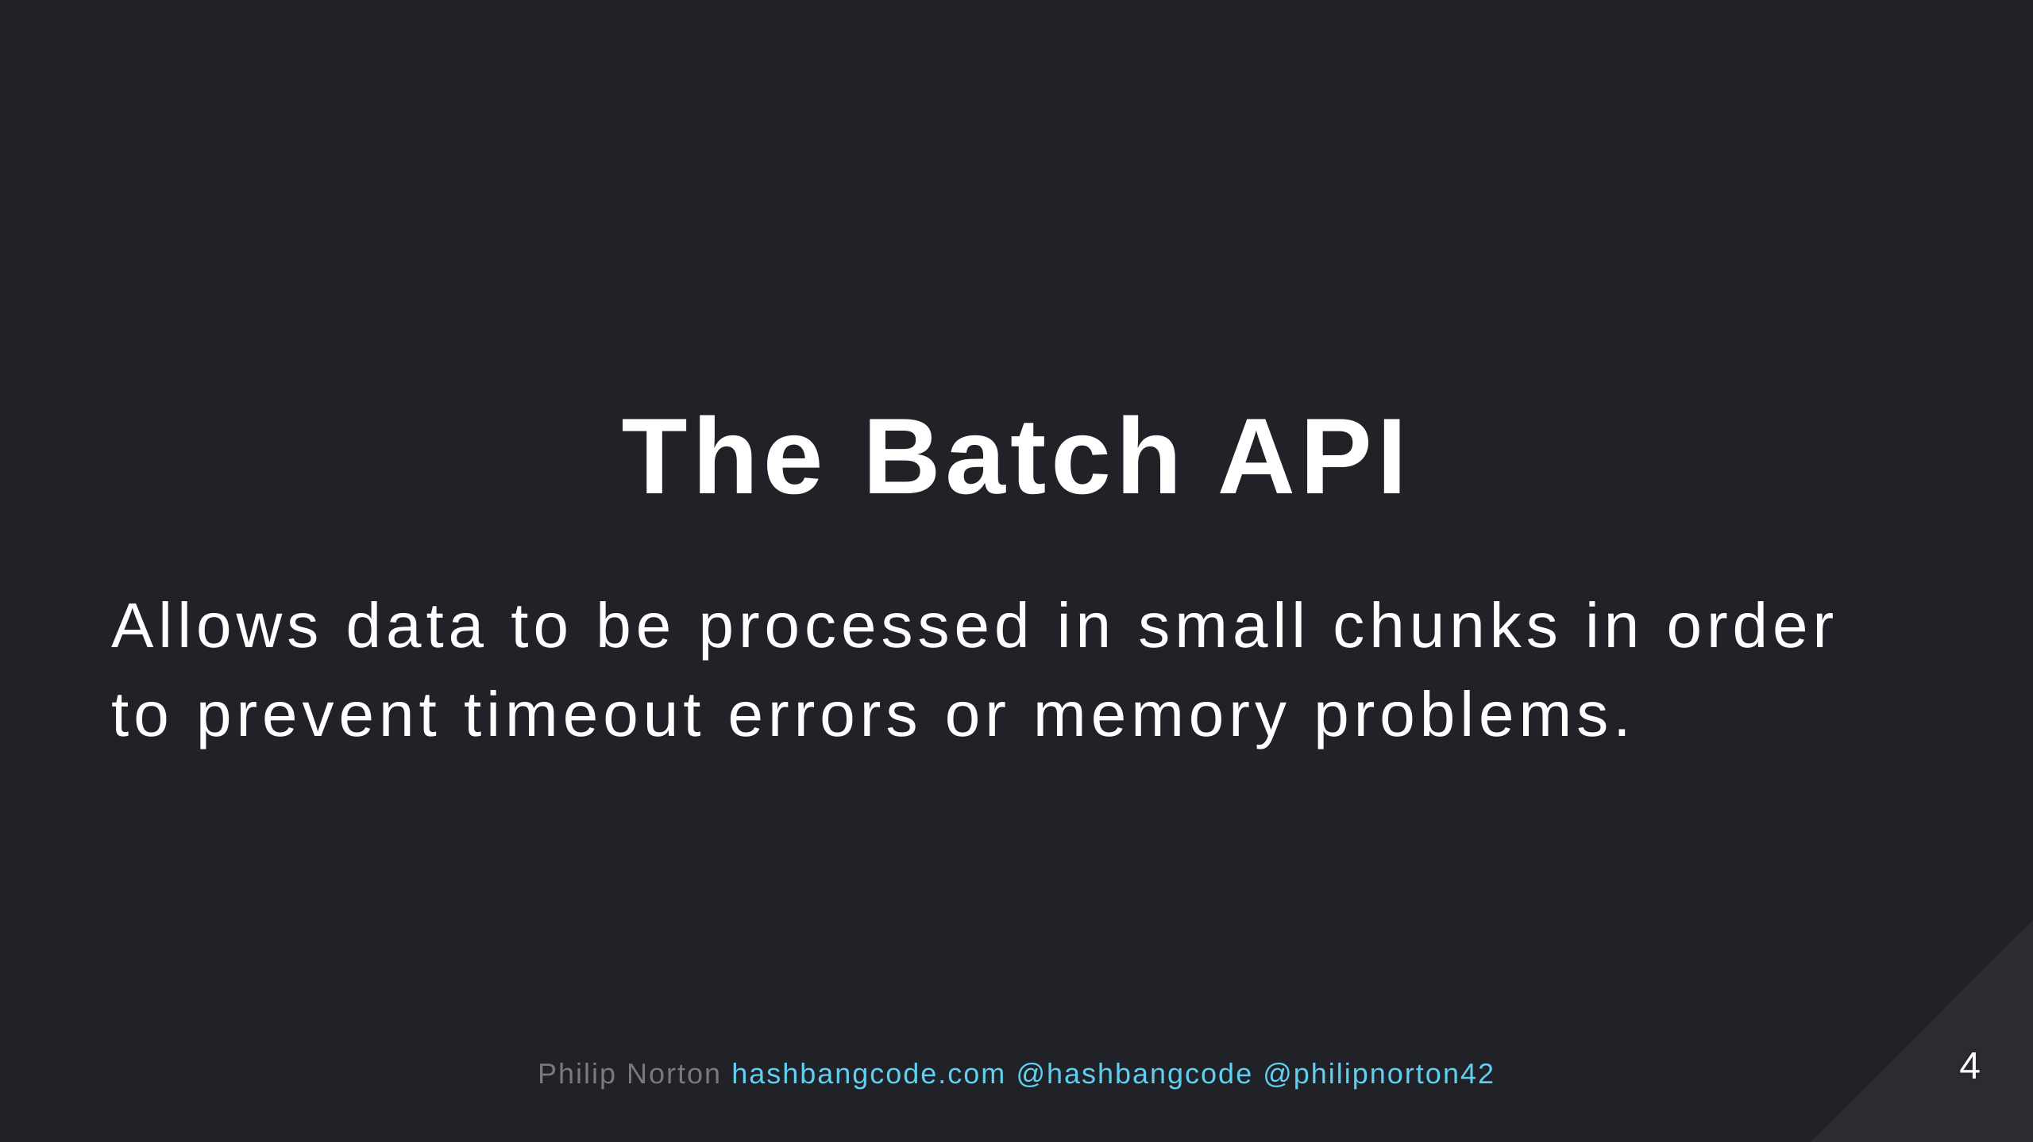

Slide 5


Slide 6
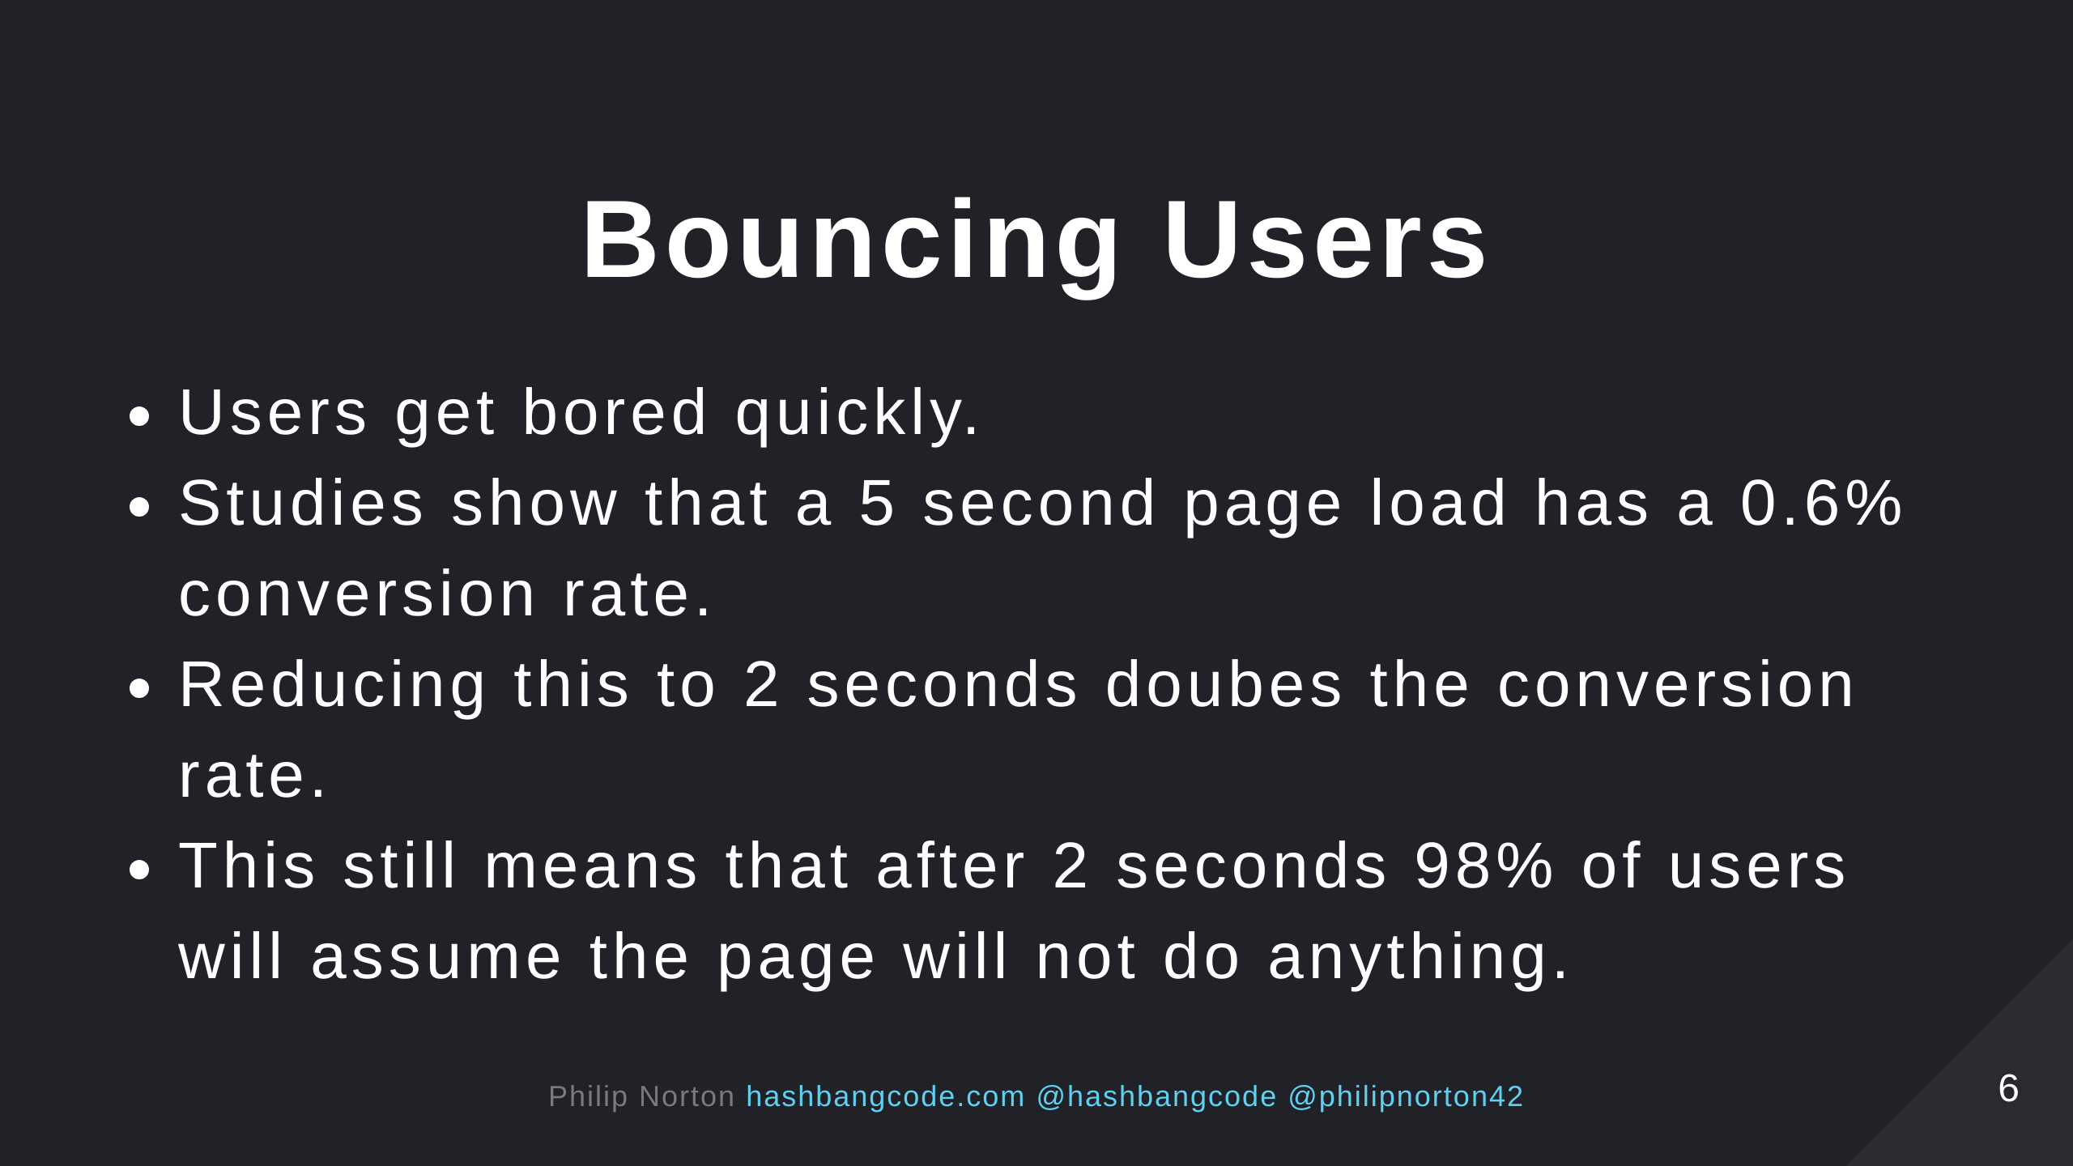
Notes:
https://www.cloudflare.com/learning/performance/more/website-performance-conversion-rates/

Slide 7
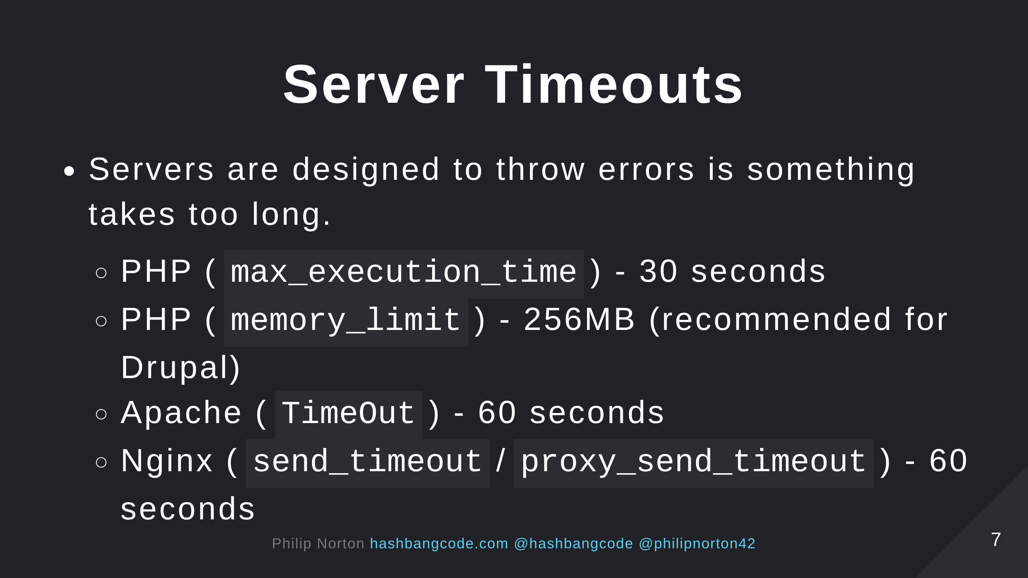
Notes:
You can override all these options. But, setting them high would cause problems on your web server. Think about how long a page request should take in you web server. 2-5 seconds MAX!

Slide 8


Slide 9
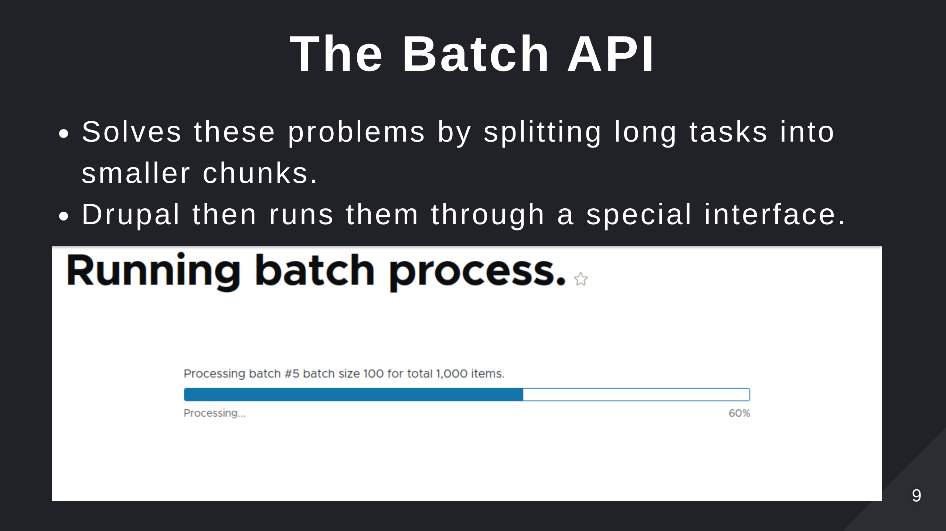

Slide 10


Slide 11
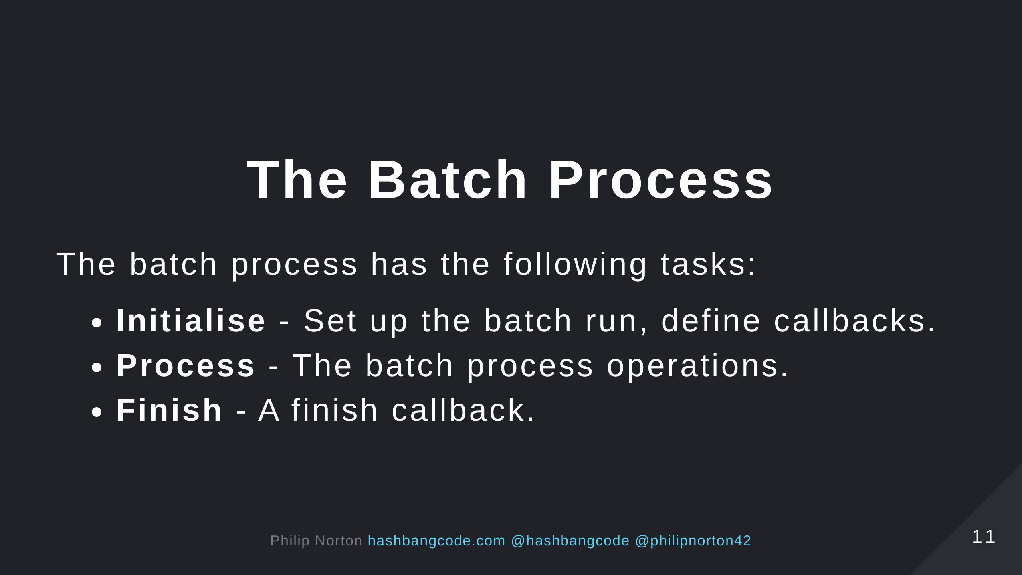

Slide 12
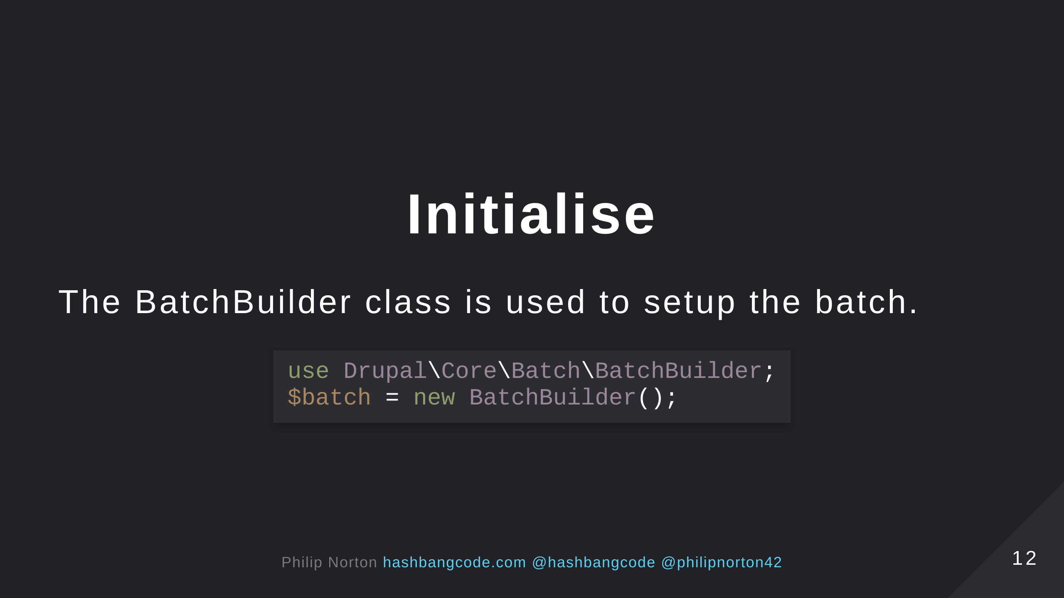

Slide 13
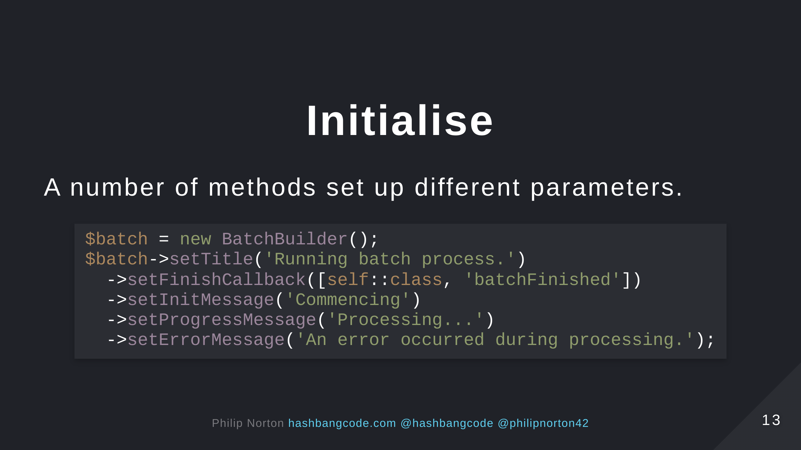

Slide 14
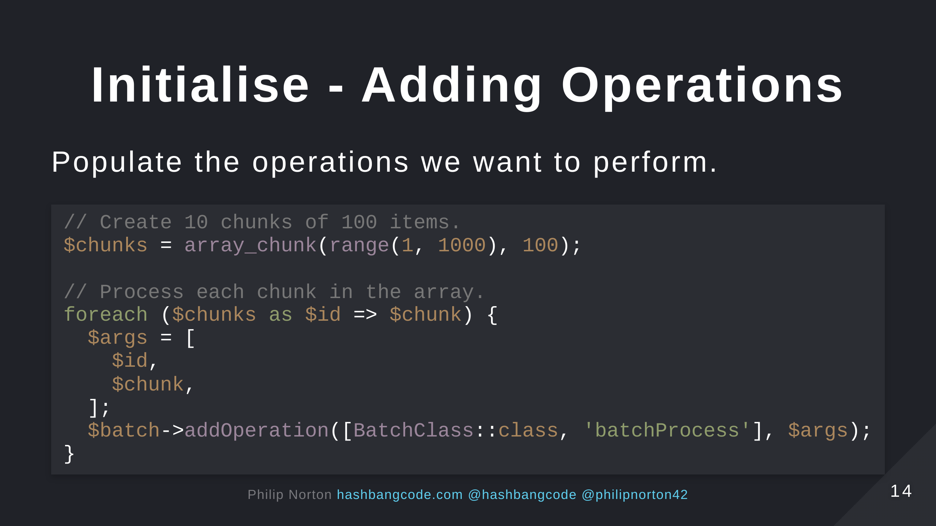

Slide 15
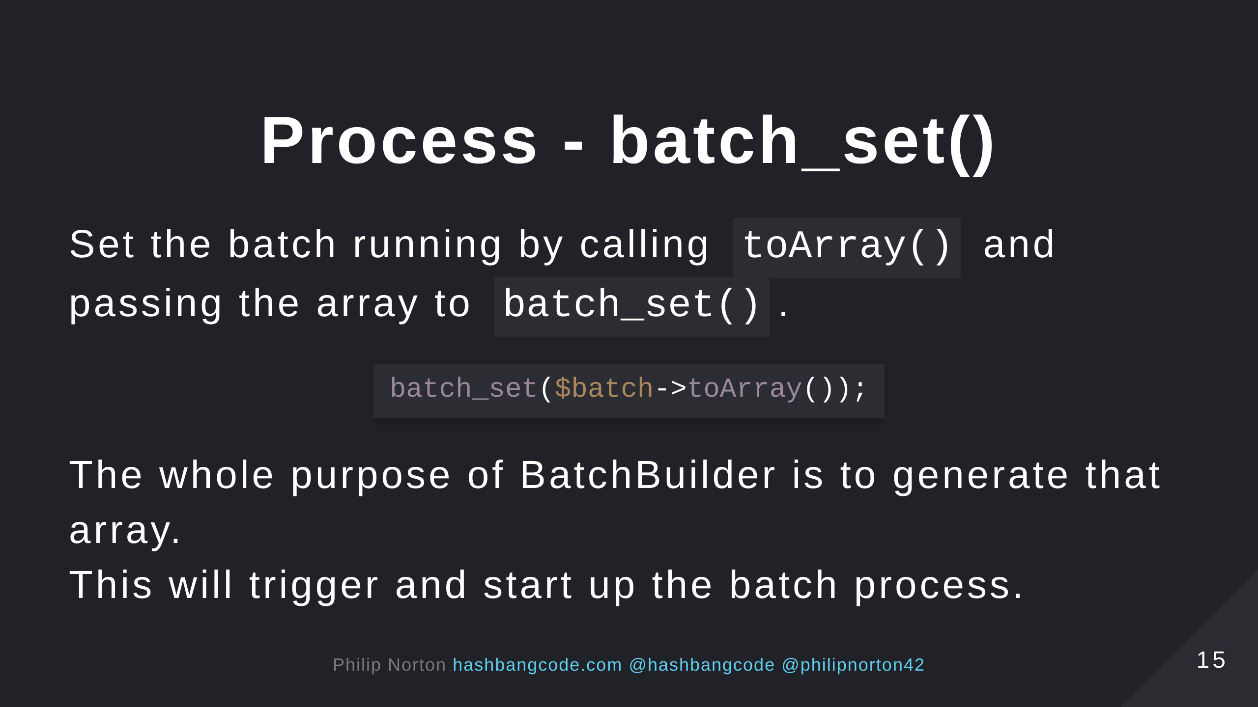

Slide 16
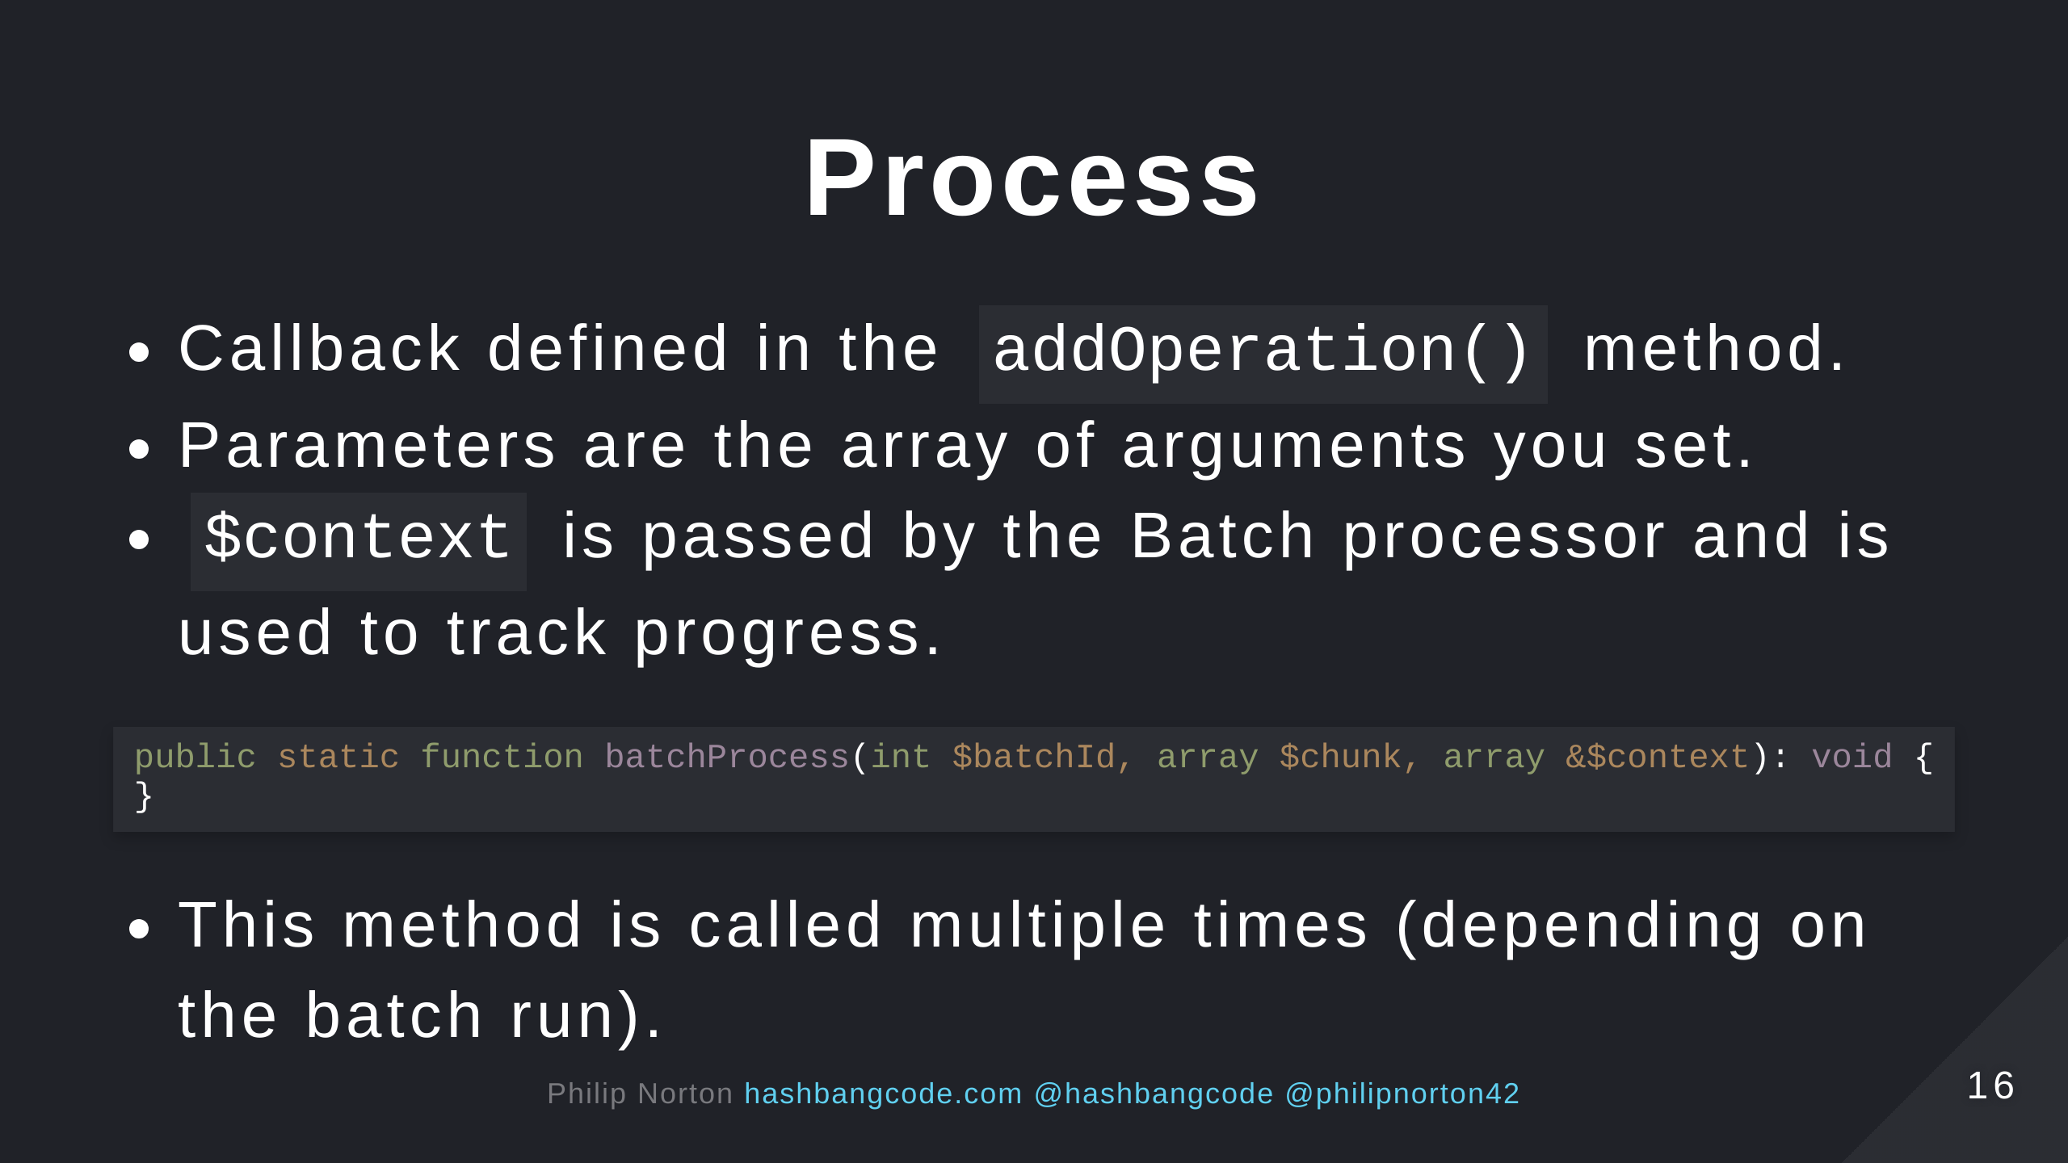

Slide 17
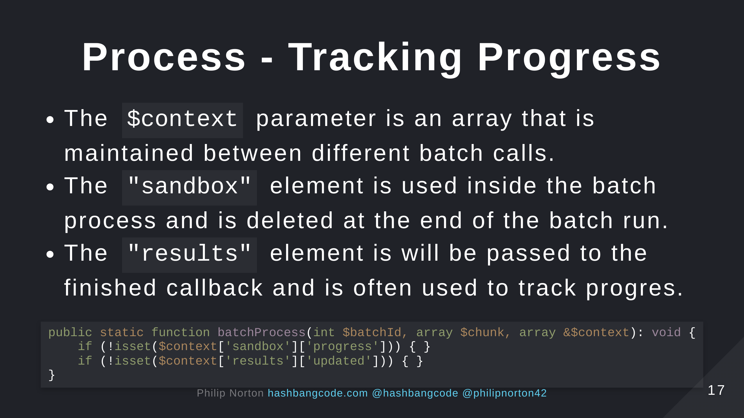

Slide 18
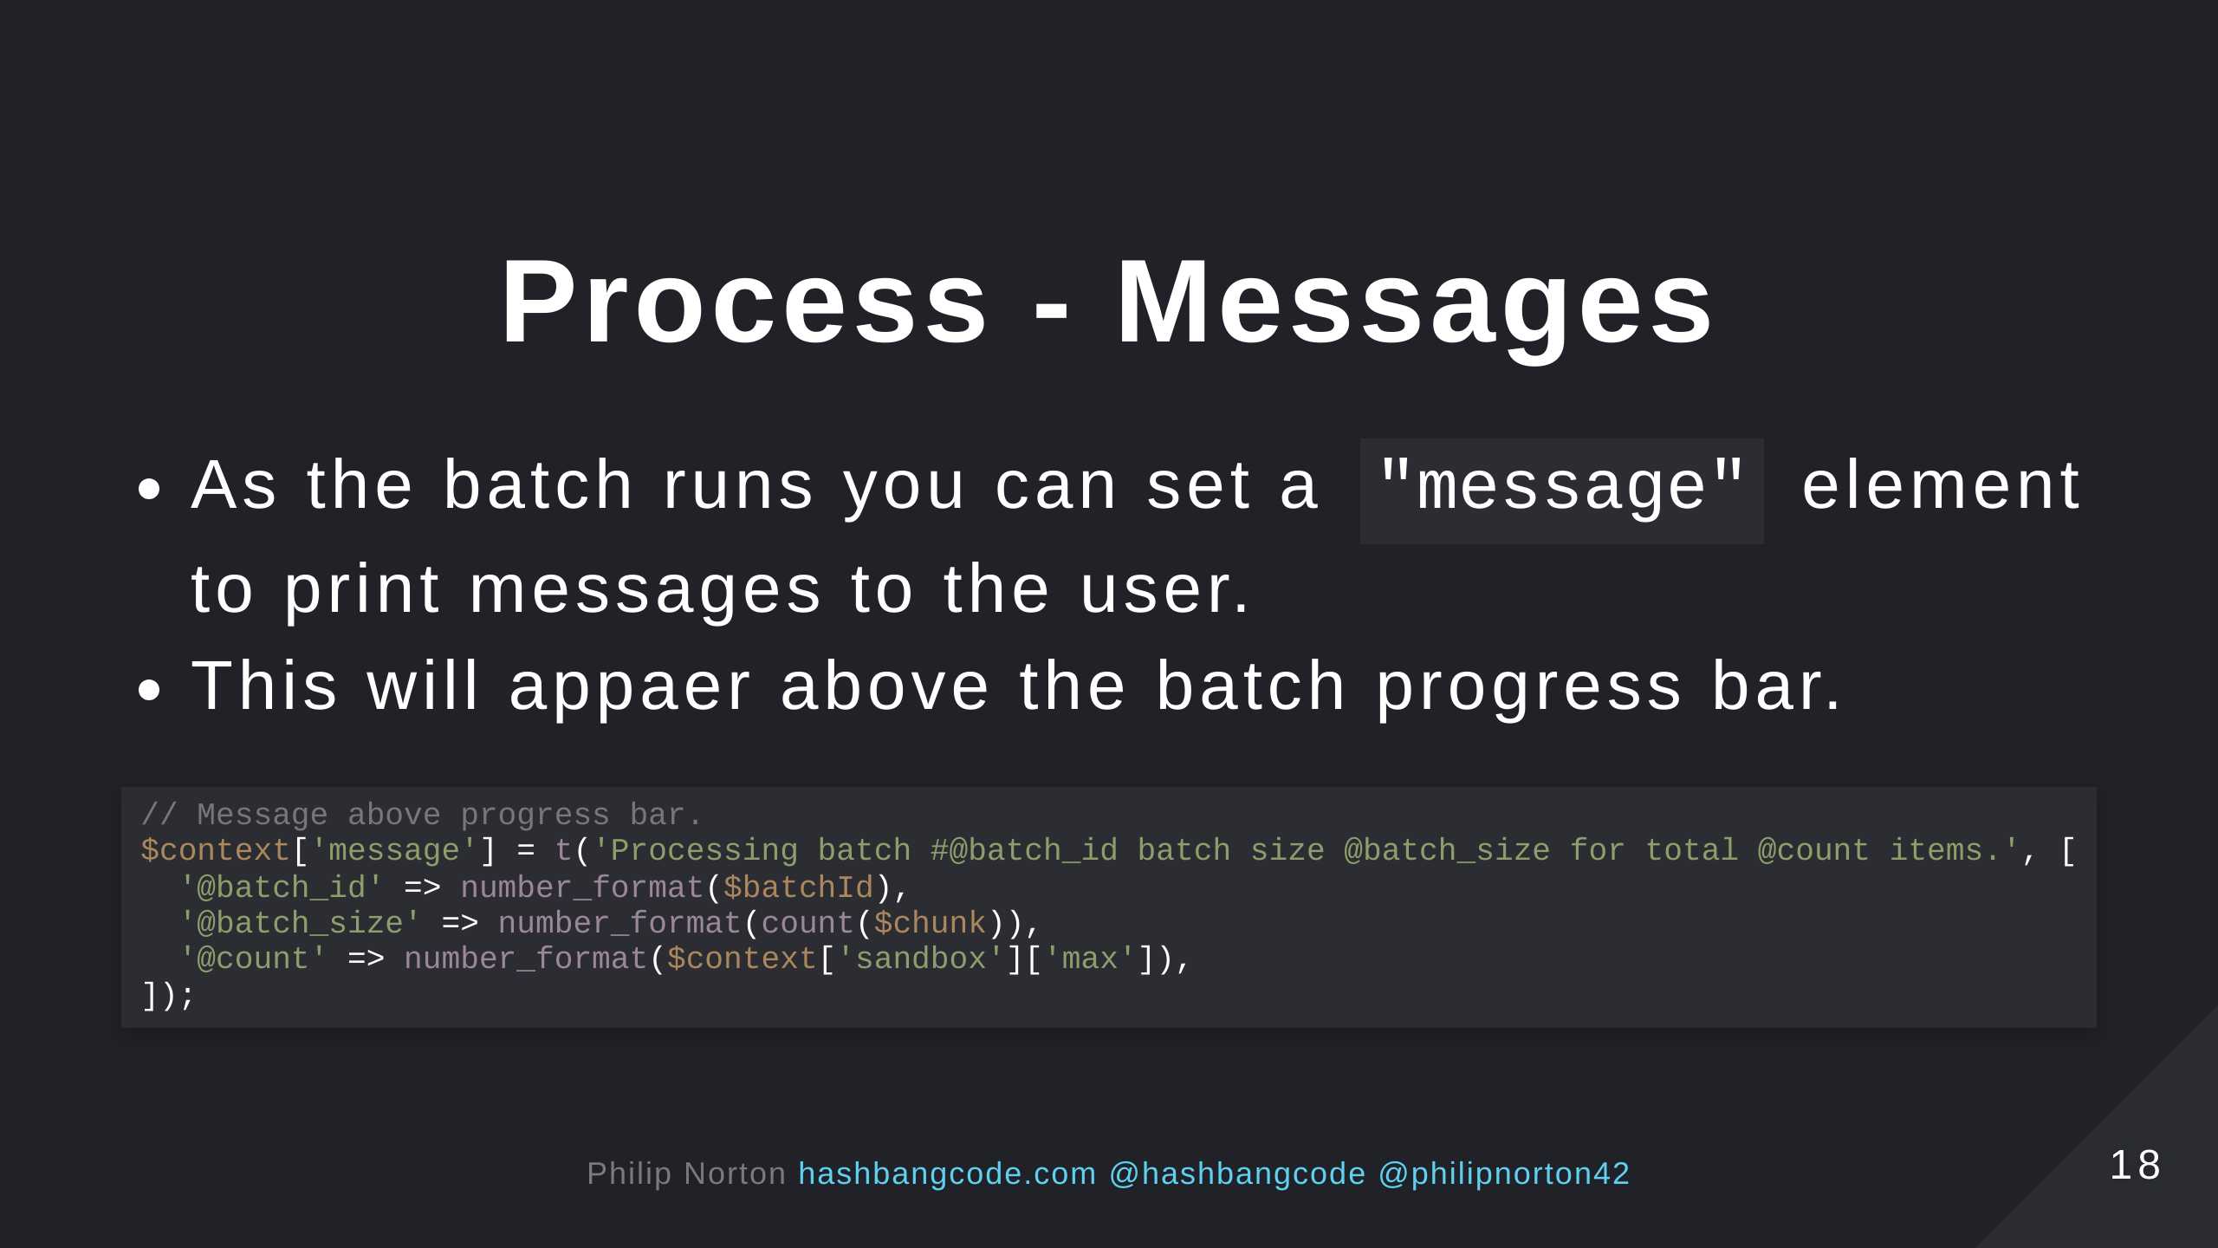

Slide 19
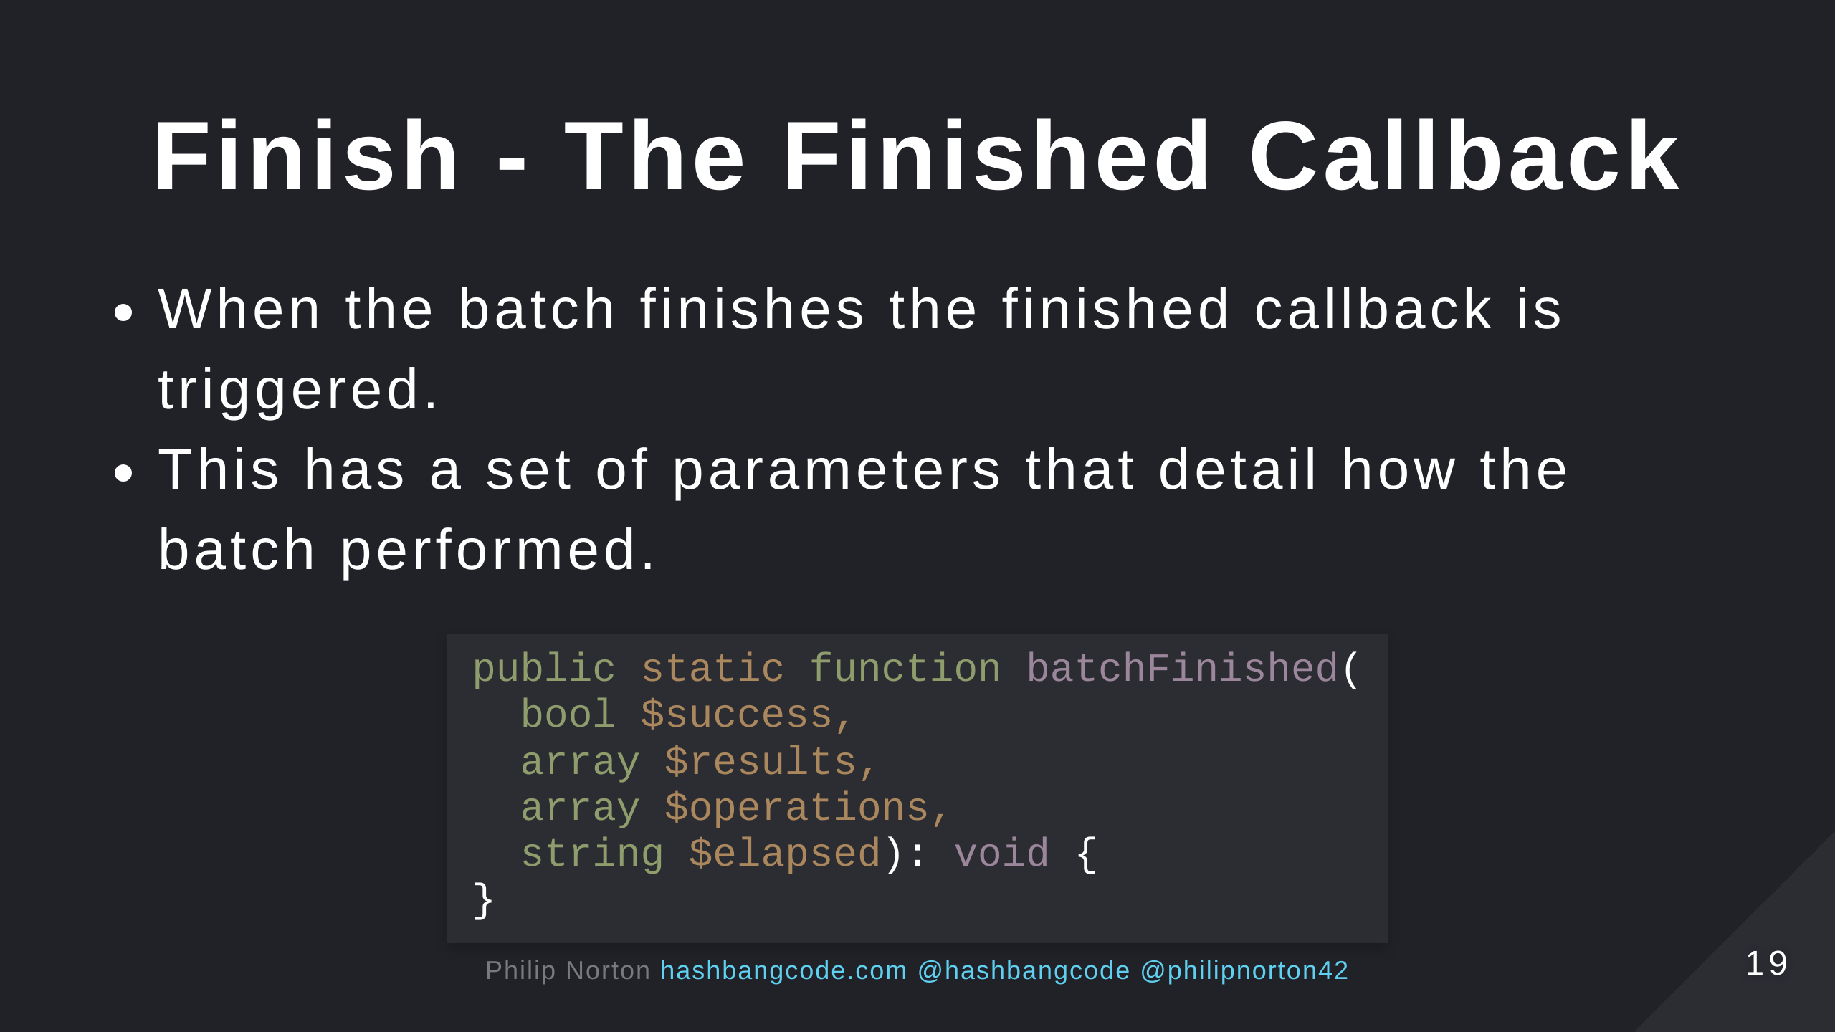
Notes:
$success - TRUE if all batch API tasks were completed successfully. $results - An results array from the batch processing operations. $operations - A list of the operations that had not been completed. $elapsed - Batch.inc kindly provides the elapsed processing time in seconds.

Slide 20
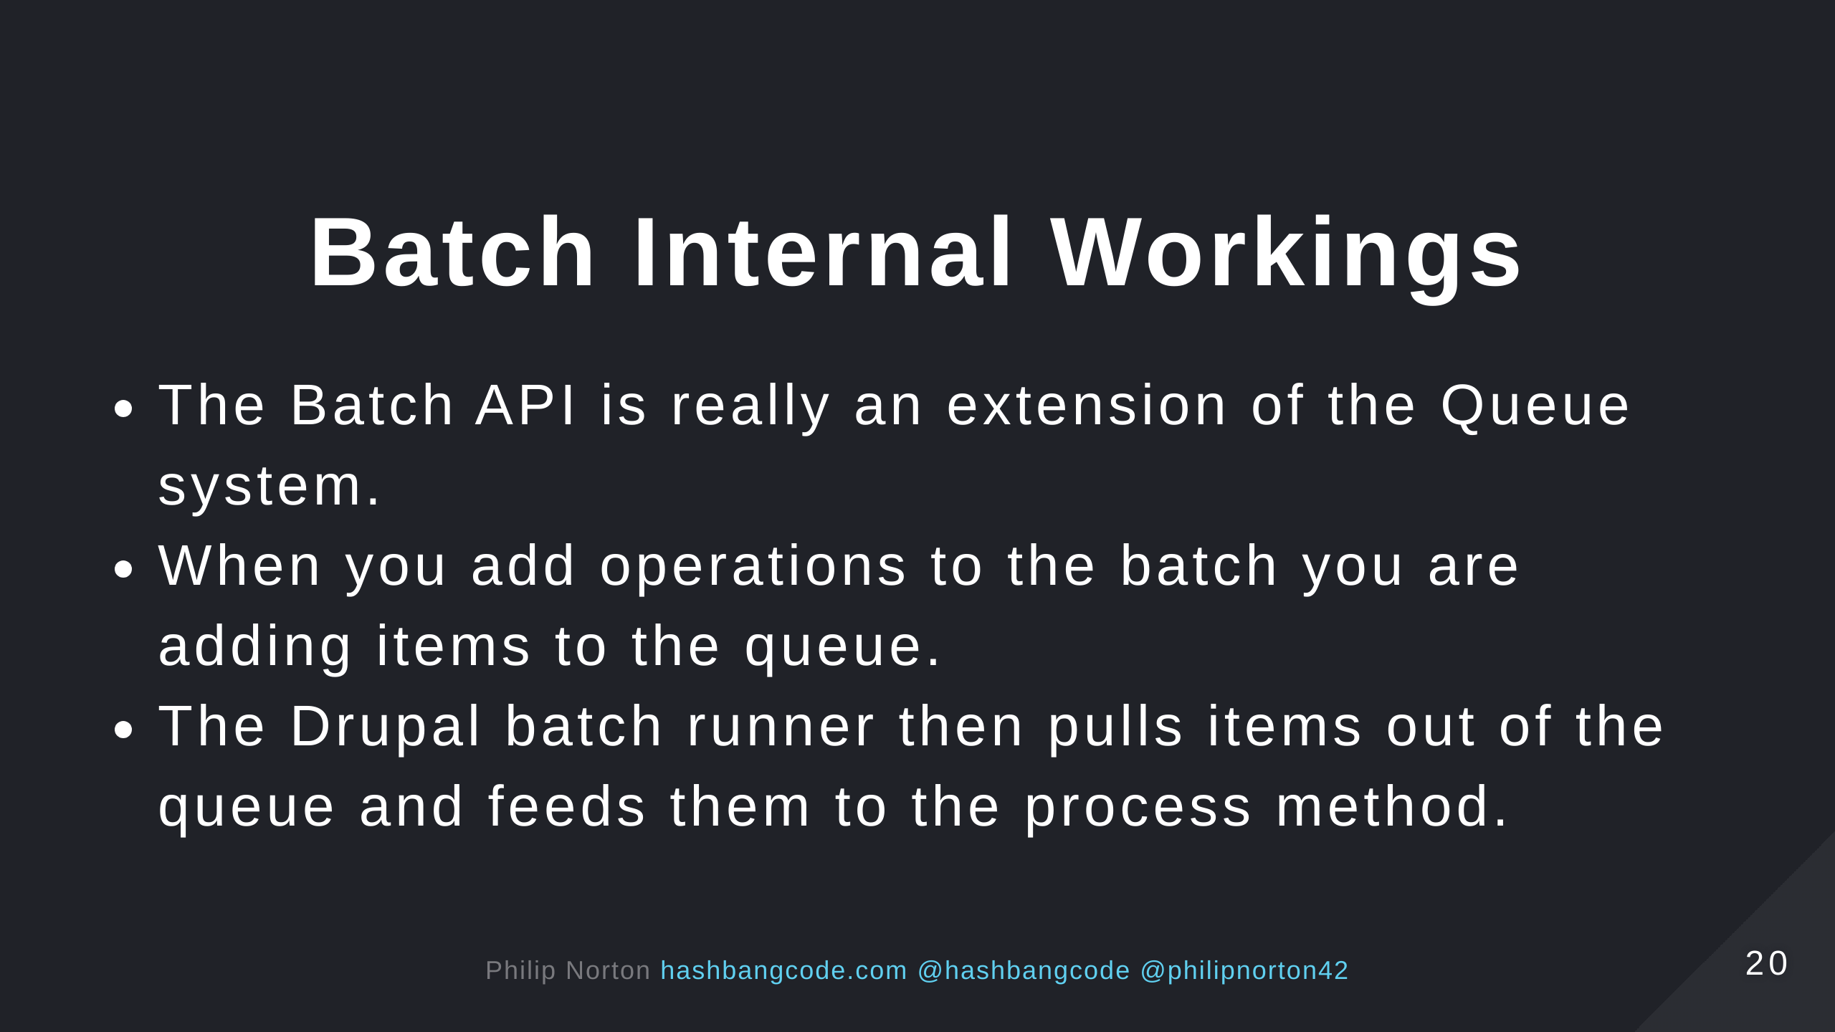

Slide 21


Slide 22
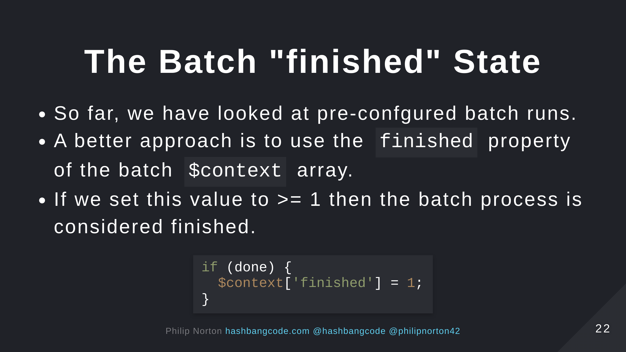

Slide 23
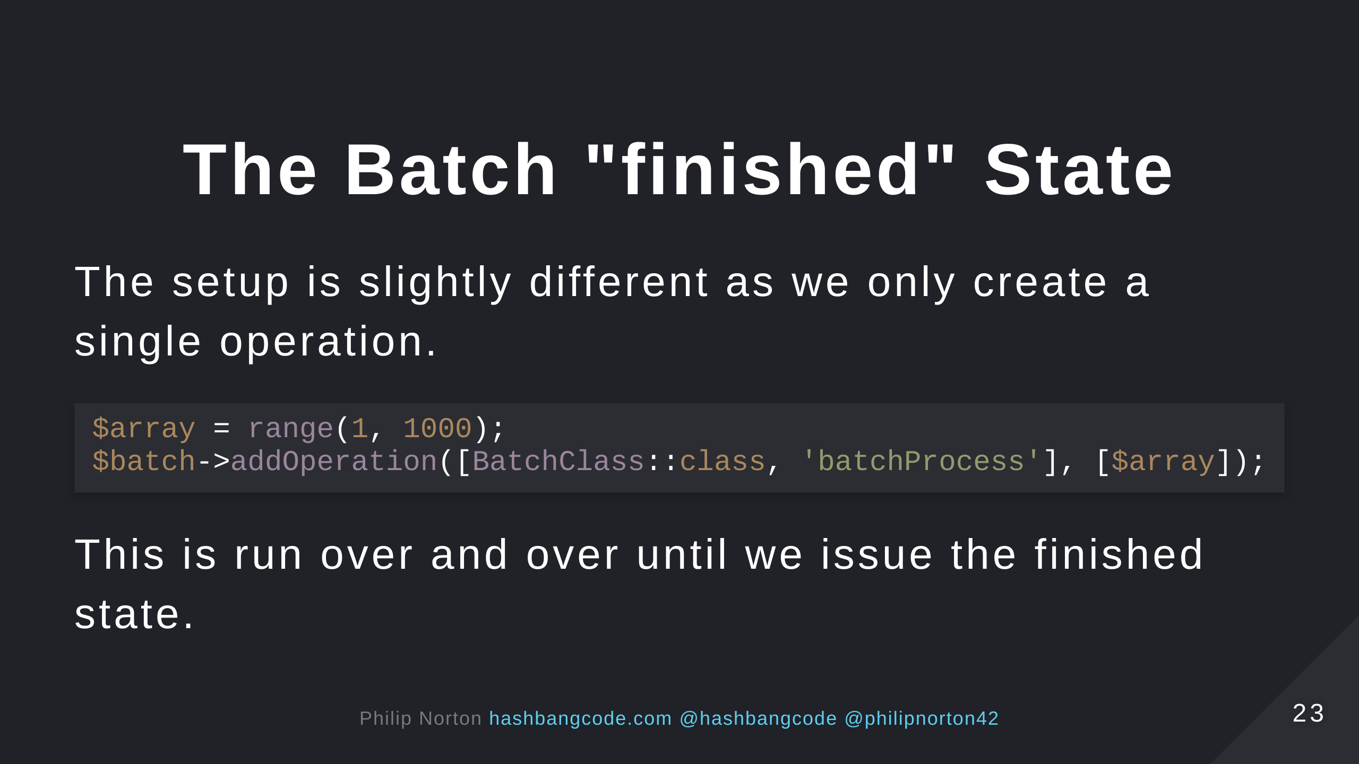

Slide 24
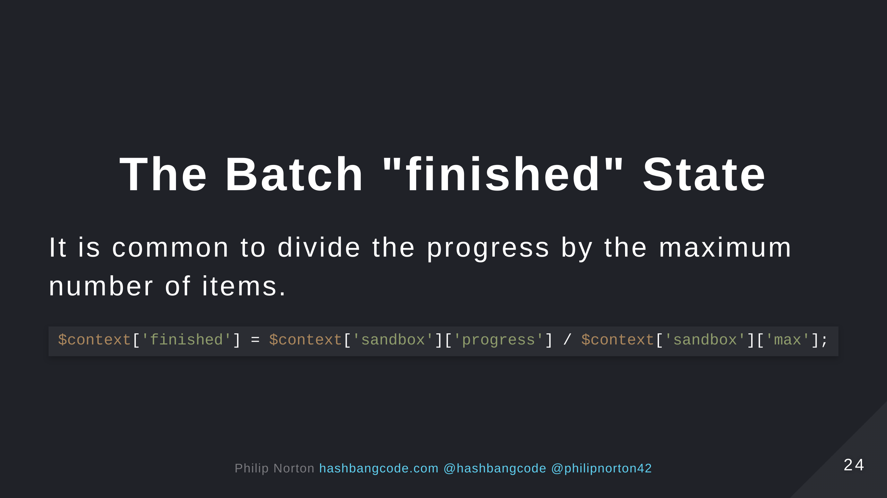

Slide 25
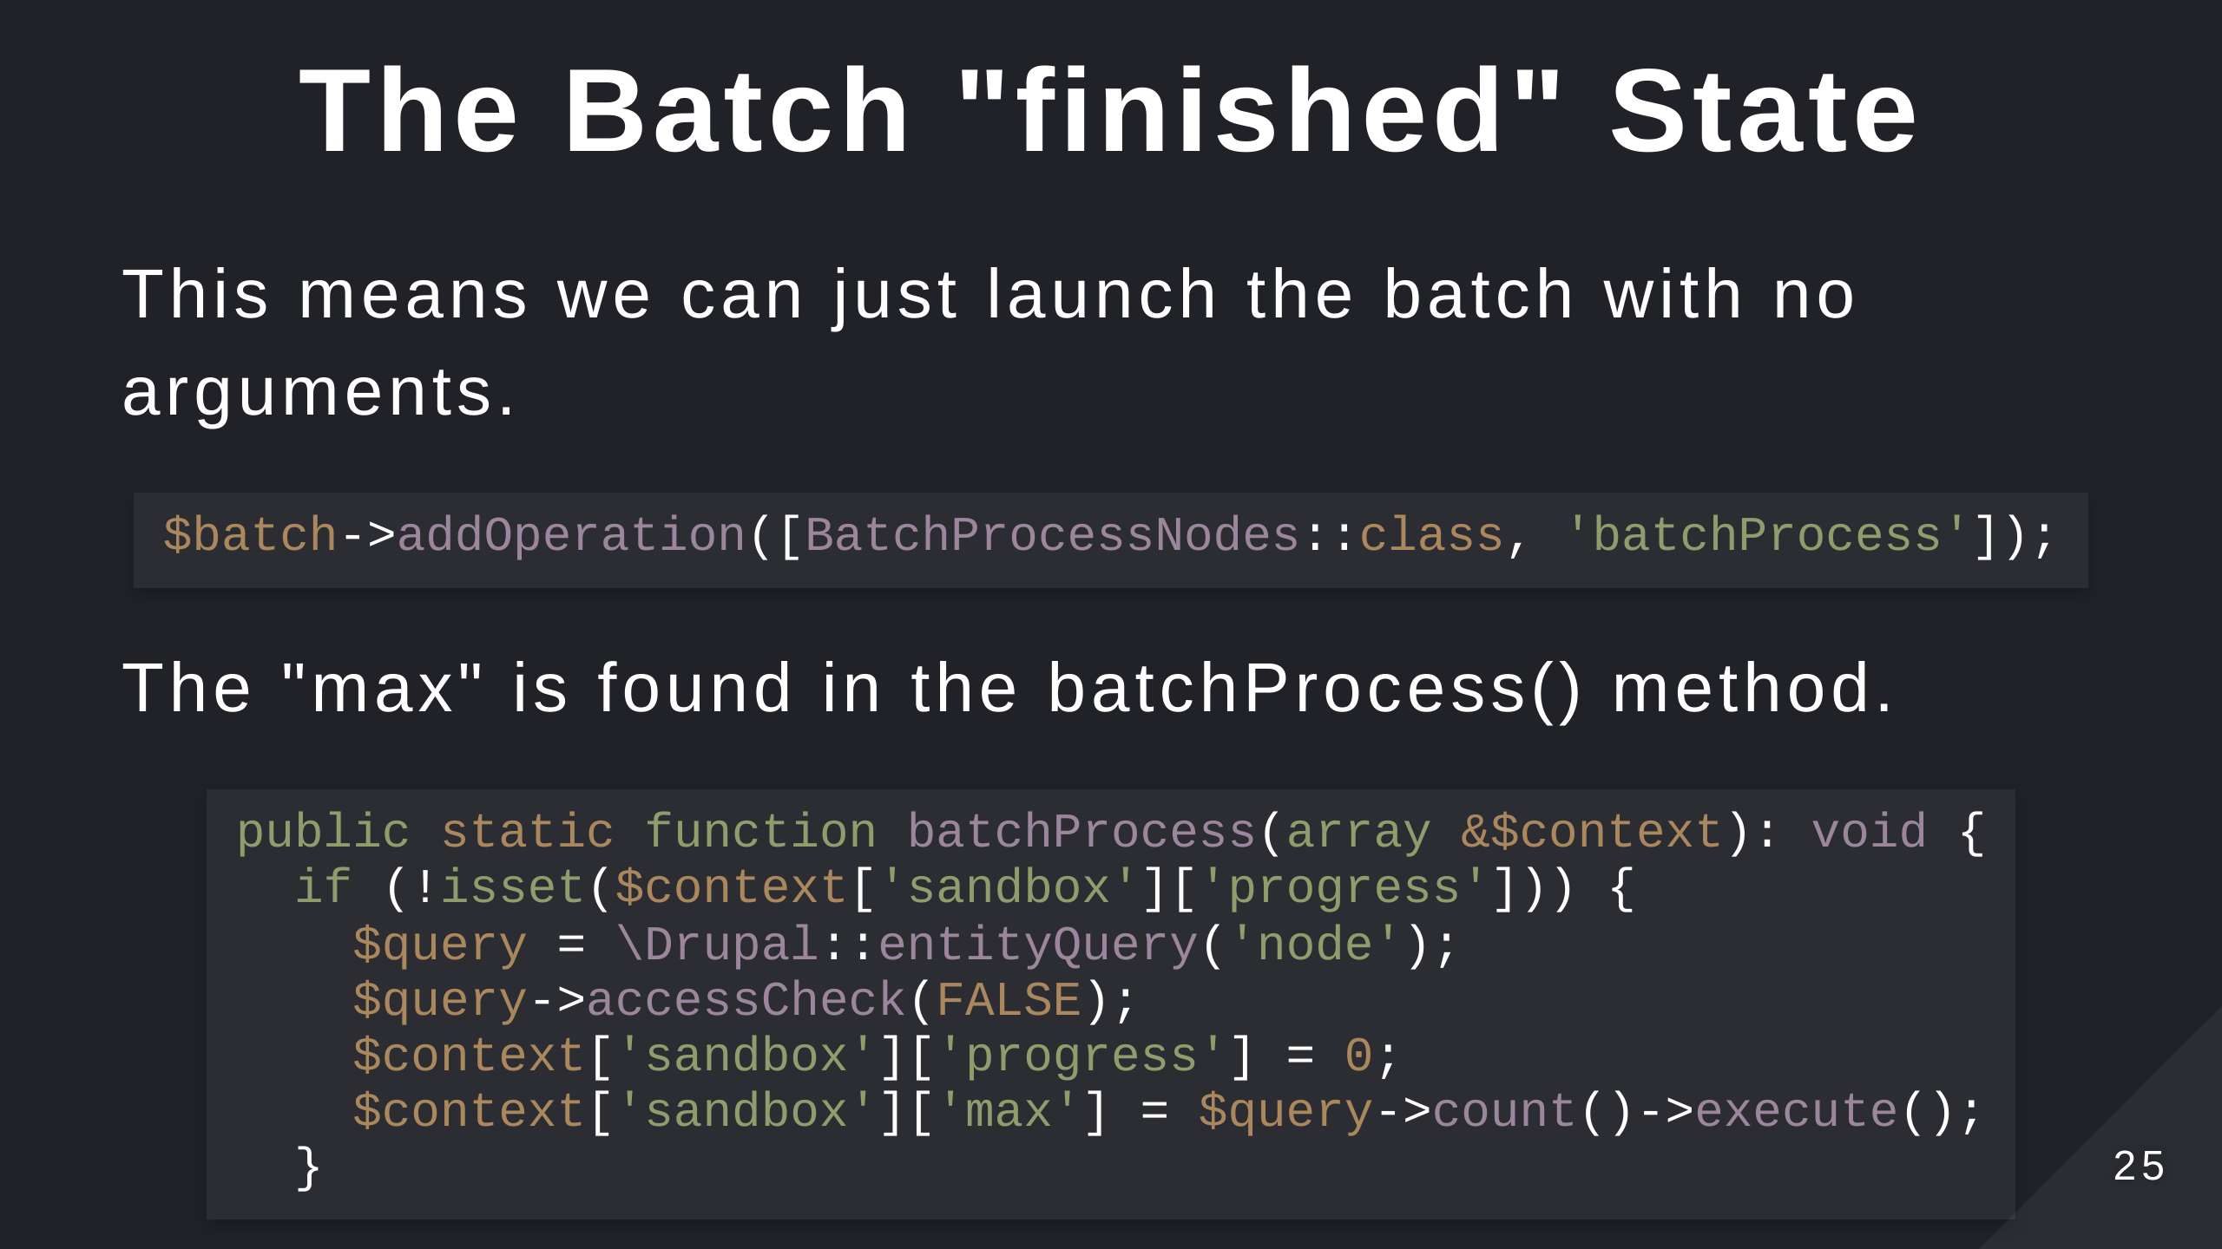

Slide 26


Slide 27
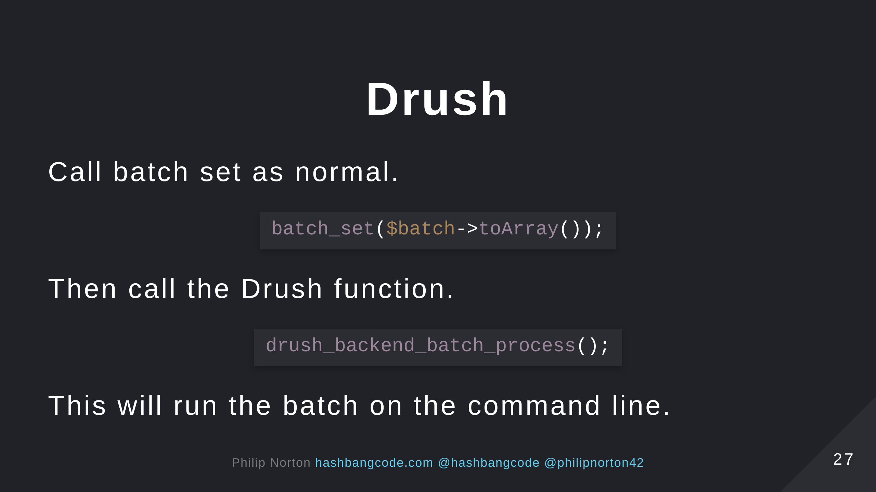

Slide 28
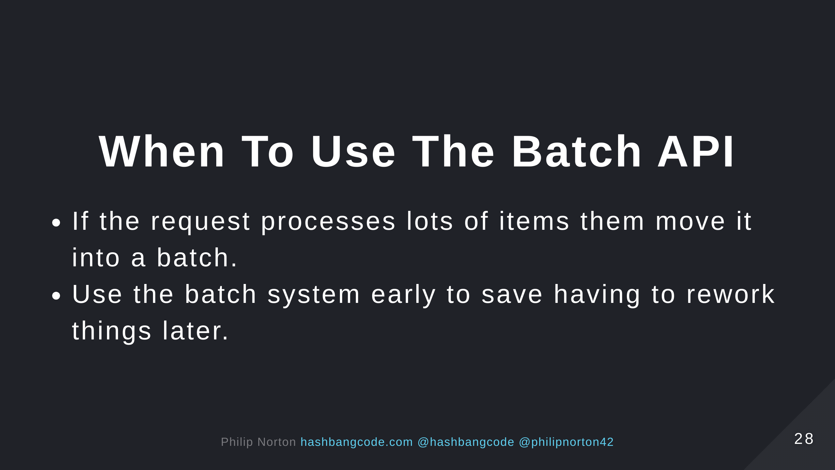

Slide 29


Slide 30


Slide 31


Slide 32
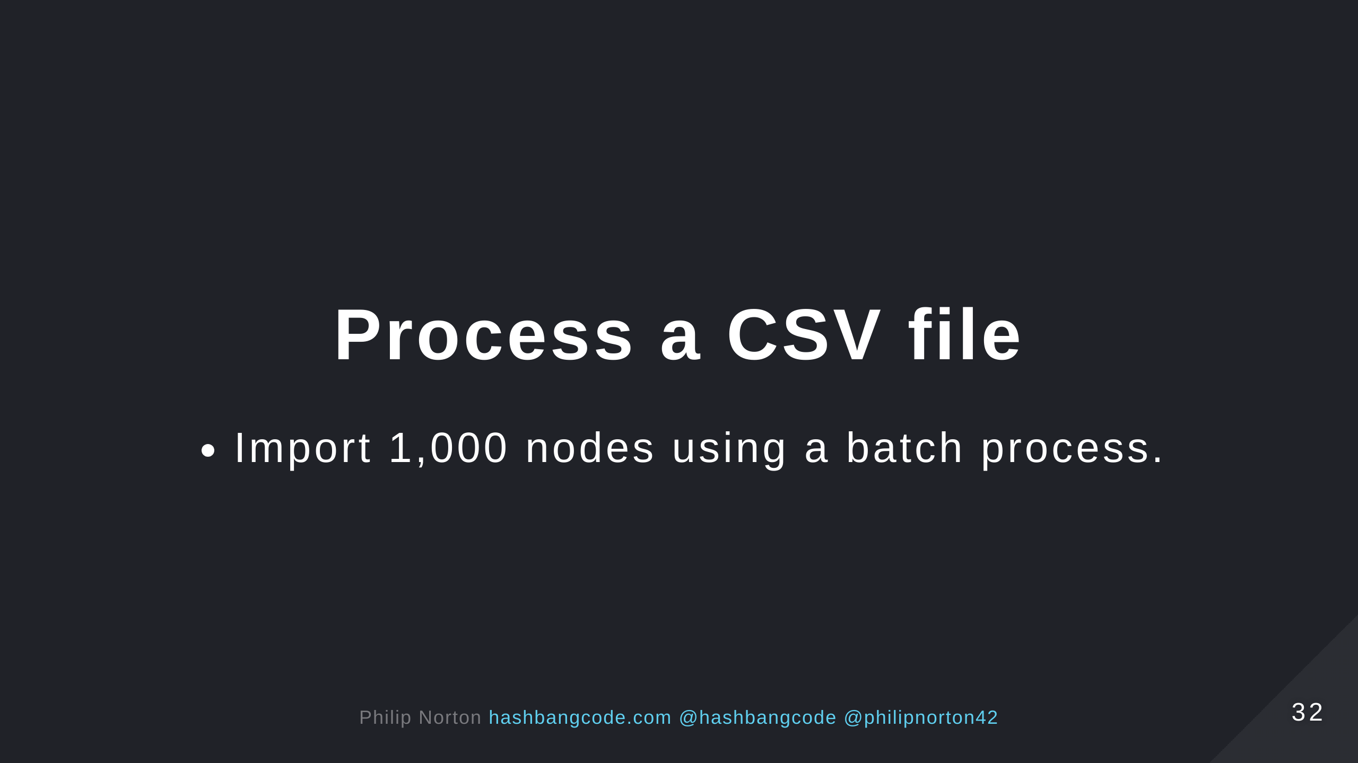

Slide 33


Slide 34


Slide 35


Slide 36


Slide 37
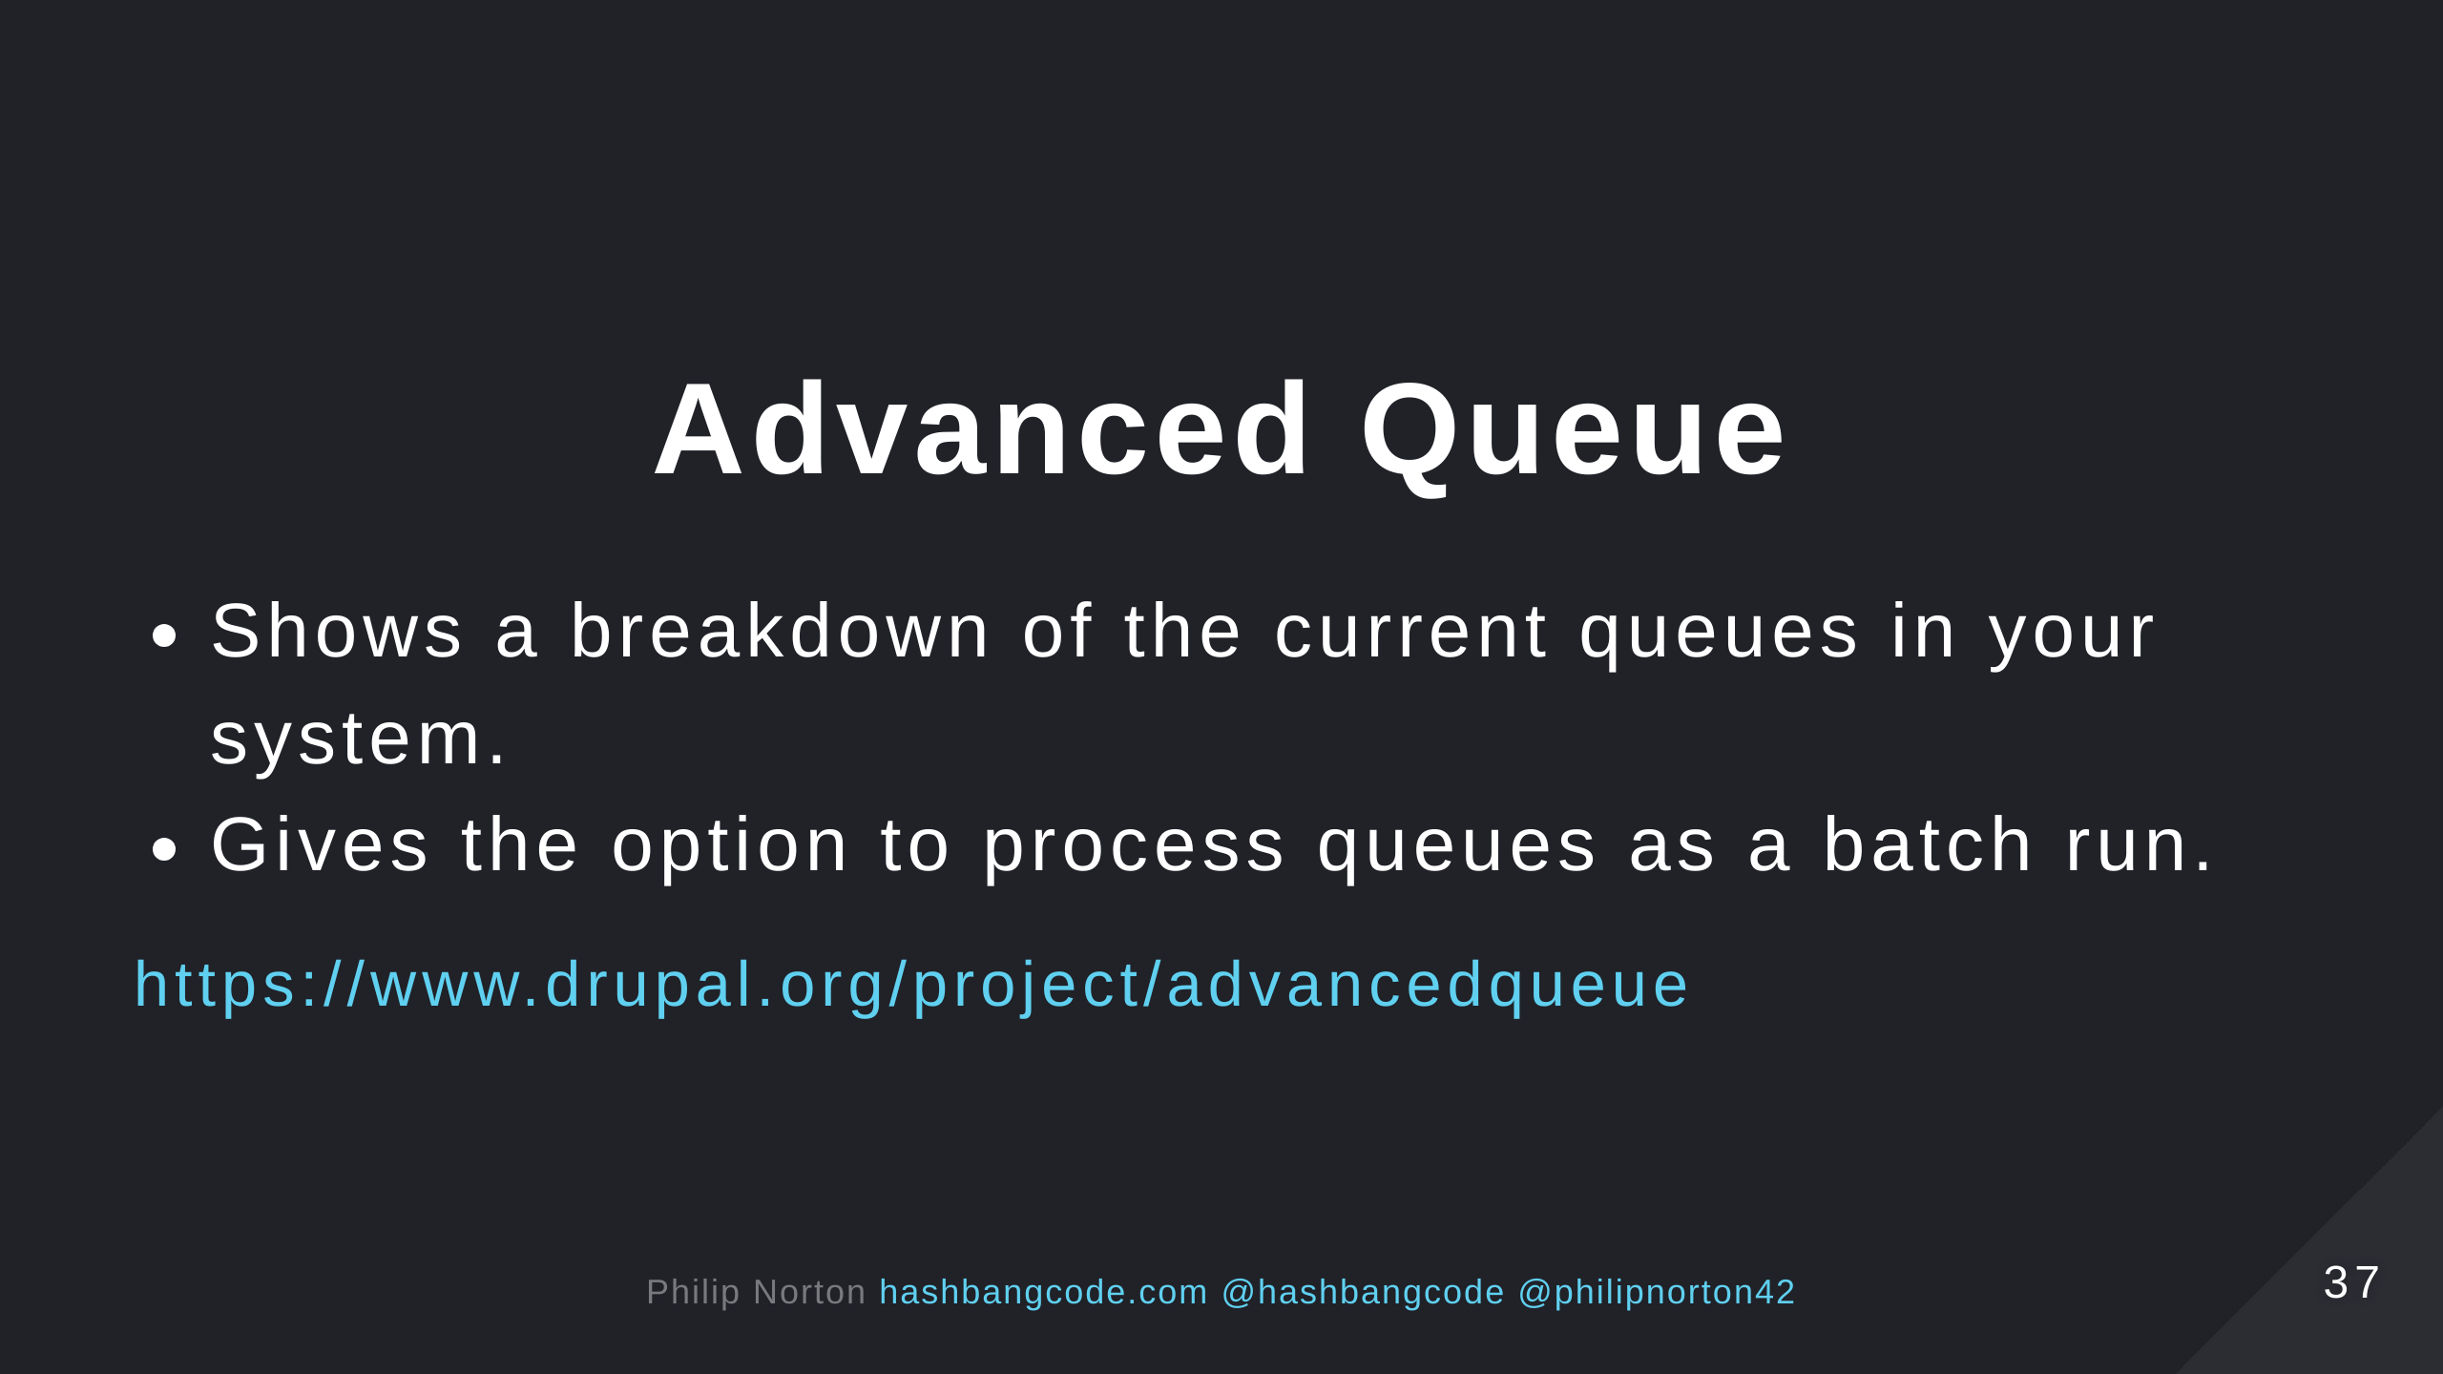

Slide 38
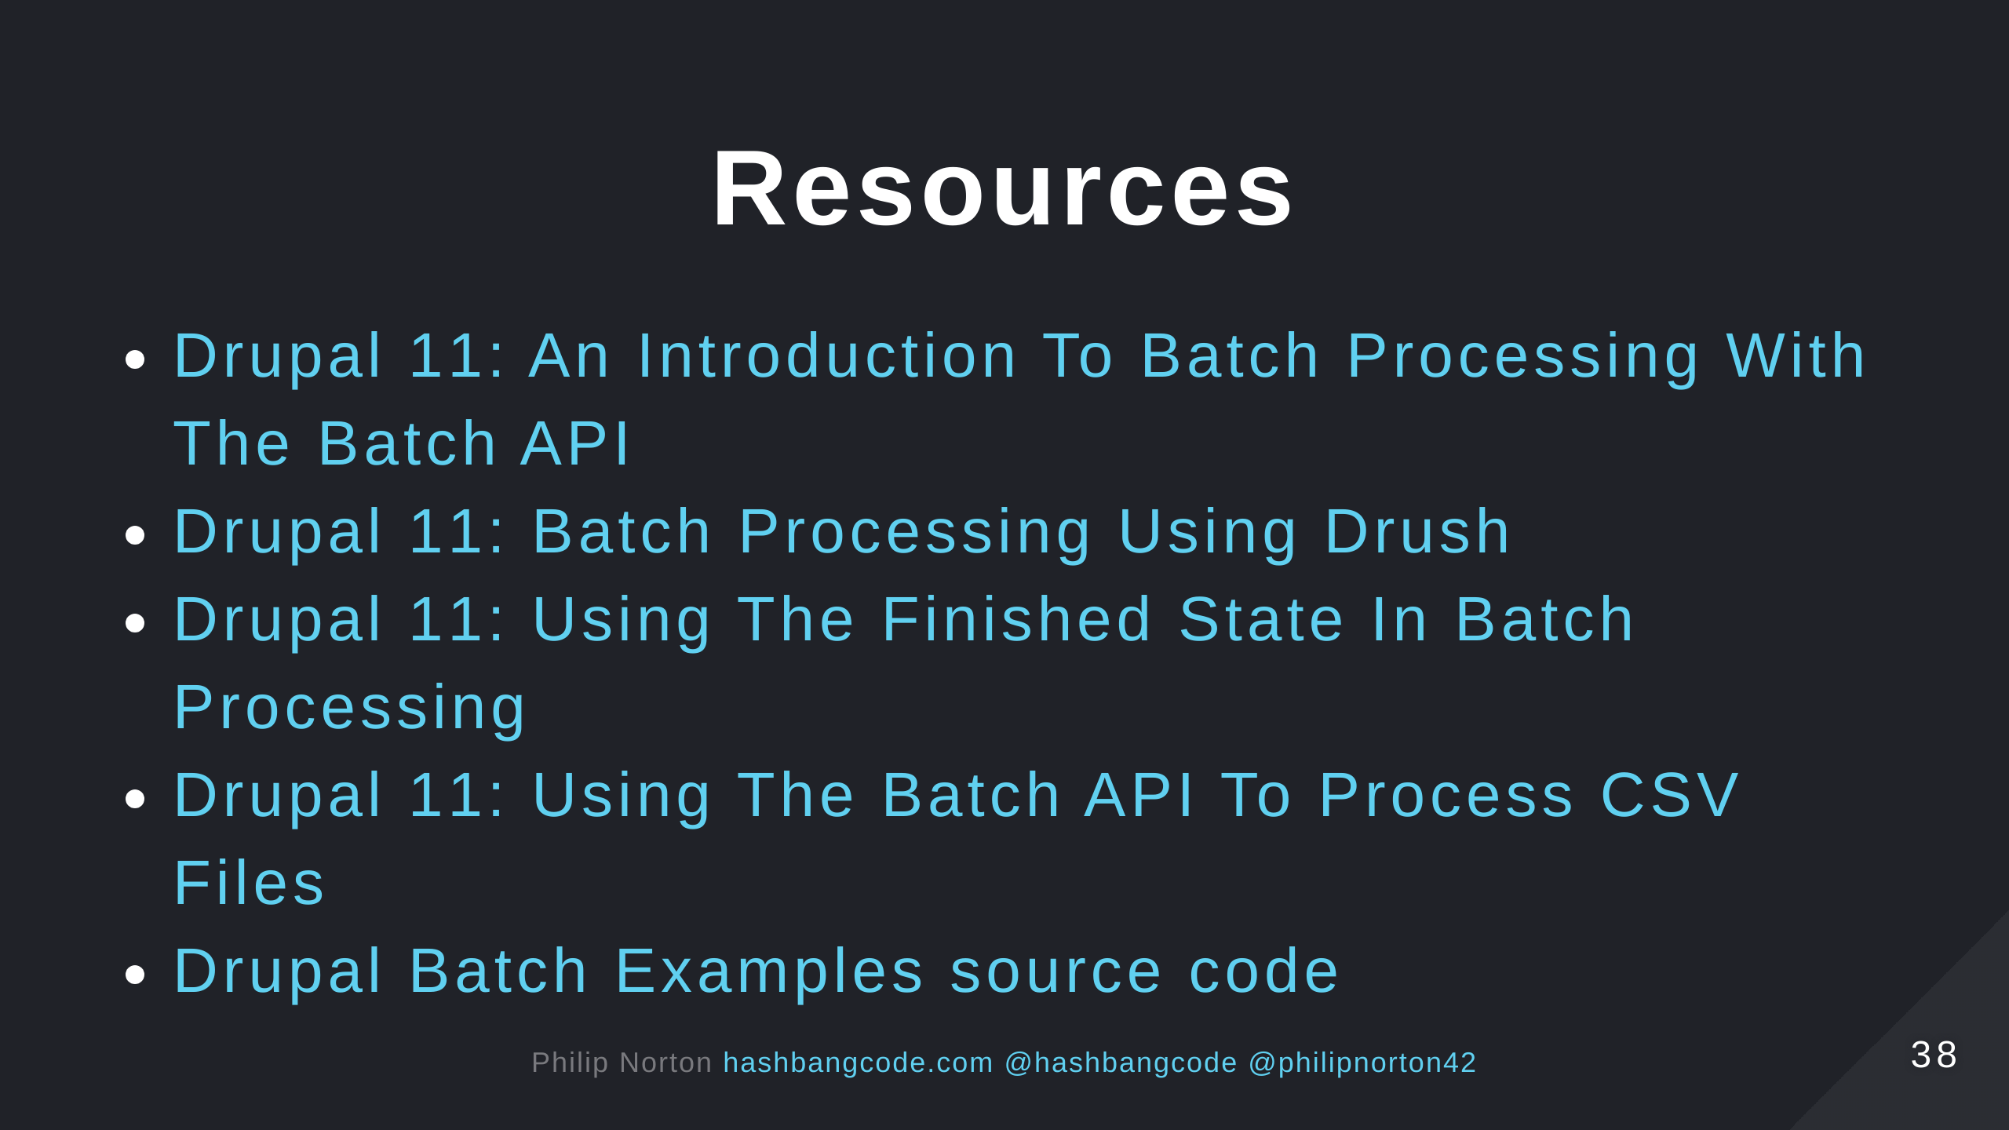

Slide 39


Slide 40


Slide 41


